Slide 1


LIBRARY
MANAGEMENT SYSTEM
EDU-BRIDGE
2021-2022
Prepared by:
NAME :M.VIGNESH
BATCH NO :2021-6312
Enrollment Number :EBEON1121477091
GUIDED BY : MR. ROHIT

Slide 2
Contents
INTRODUCTION
PURPOSE
PRODUCT SCOPE
SOFTWARE USED
ANGULAR+SPRINGBOOT CURD FULL STACK ARCHITECTURE
APPLICATION PROPERTIES
CREATING AN ANGULAR PROJECT
SCREEN SHOTS
CREATING SPRING BOOT PROJECT
APPLICATION PROPERTIES
HOME PAGE
CONTACT US
ADD BOOK RECORDS
UPADATE BOOK RECORDS
DELETE&VIEW
MY SQL SCREEN SHOTS
GITHUB LINK
THANKYOU

Slide 3
Introduction
The project “Library Management System” which mainly focuses on basic operations in a library like adding new member, new books, and updating new information, Using this web application user can make the booking of books online and can look for the book either it is available in library or not.

Slide 4
Purpose
1. It provides "better and efficient" service to members.
2. Reduce the workload of librarian.
3. Faster retrieval of information about the desired book.
4. Provide facility for proper monitoring reduce paper work
and provide data security.

Slide 5
Product scope
Any education institute & government office’s can make use of it for providing information about book id, book name content available etc..
This project can further be extended by adding the facility of e-books to overcome the problem of stock in library.

Slide 6
Software-used
Operating system : Windows 11
Front End : Angularjs with node
Back End : Spring boot with maven and hibernate with
My SQL

Slide 7


ANGULAR+SPRINGBOOT CURD FULL STACK ARCHITECTURE
View Templates
Components
Services
HTTP Client
Spring Rest Controller
Spring Data JPA
MySQL

Slide 8
server.port=9091 spring.datasource.driver-class-name=com.mysql.cj.jdbc.Driver spring.datasource.url=jdbc:mysql://localhost:3306/hotel spring.datasource.username=root spring.datasource.password=***** spring.jpa.show-sql=true spring.jpa.hibernate.ddl-auto=update spring.jpa.database-platform=org.hibernate.dialect.MySQL8Dialect spring.jpa.properties.hibernate.dialect.storage_engine=innodb logging.level.org.hibernate.SQL=DEBUG logging.level.org.hibernate.type=TRACE
APPLICATION PROPERTIES

Slide 9
CREATING AN ANGULAR PROJECT
Creating An Angular project in VSCODE by using this Command - “ng new LibraryMgmt
So what we will add in angular app,
Components:
Add-Component
Fetch-Component
Delete-Component
Update-Component
About-Component
Contact-Component
Home-Component
Command used to create Components : ” ng g c componentname ”
Service :
Hotel.service
Command used to create Service : ” ng g s servicename

Slide 10
SCREEN SHOTS

Slide 11
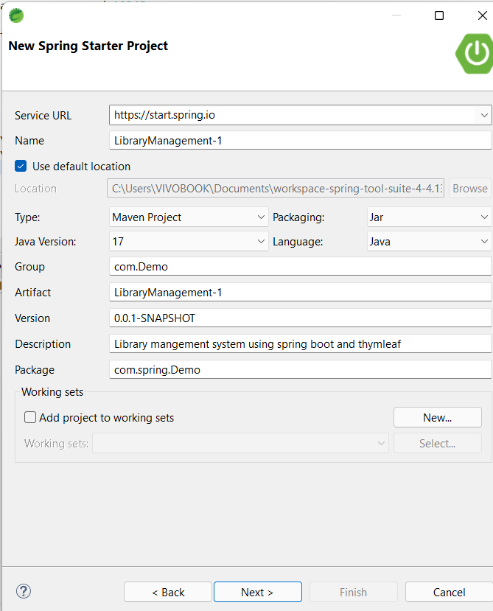
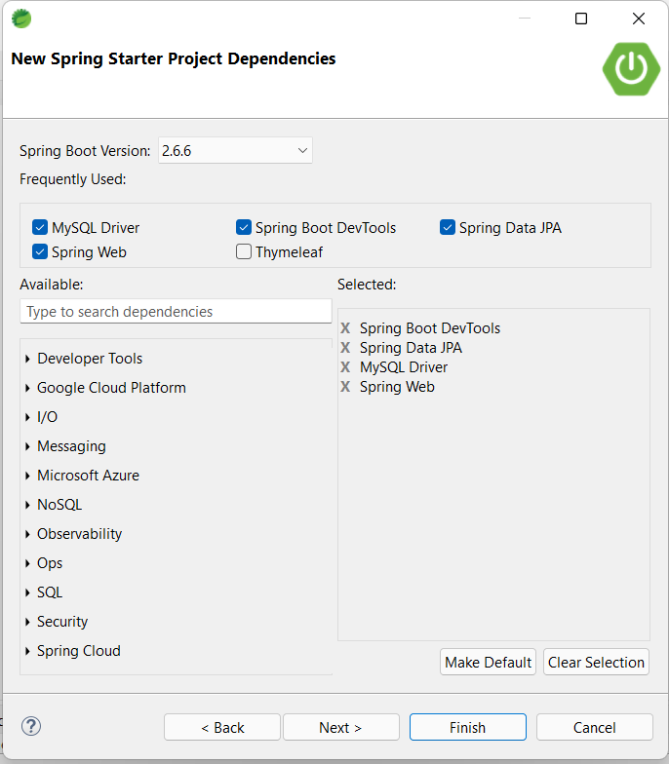
CREATING SPRING BOOT PROJECT

Slide 12
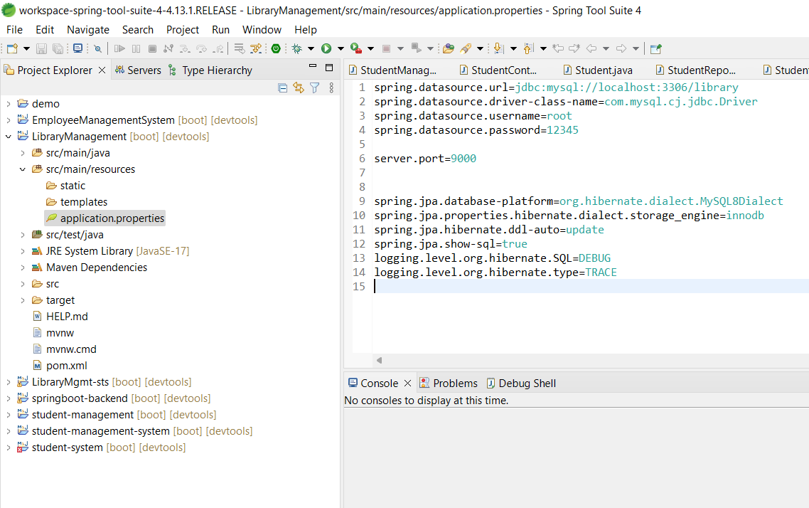
APPLICATION PROPERTIES
SCREEN SHOT

Slide 13
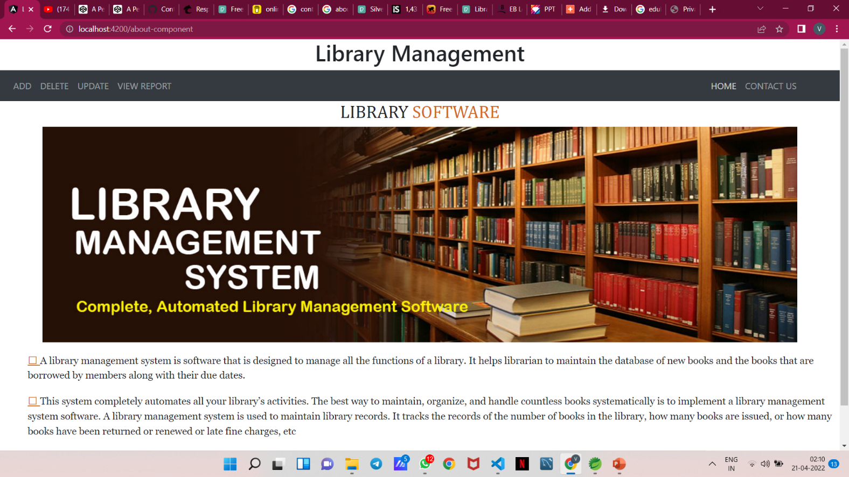
1. HOME PAGE

Slide 14
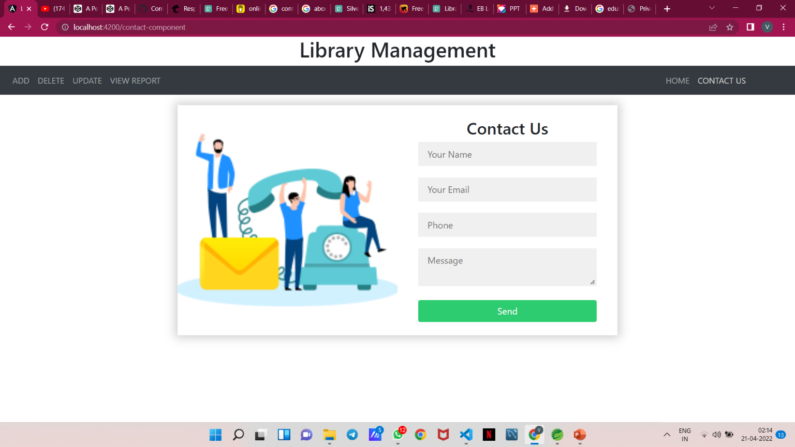
2. CONTACT US

Slide 15
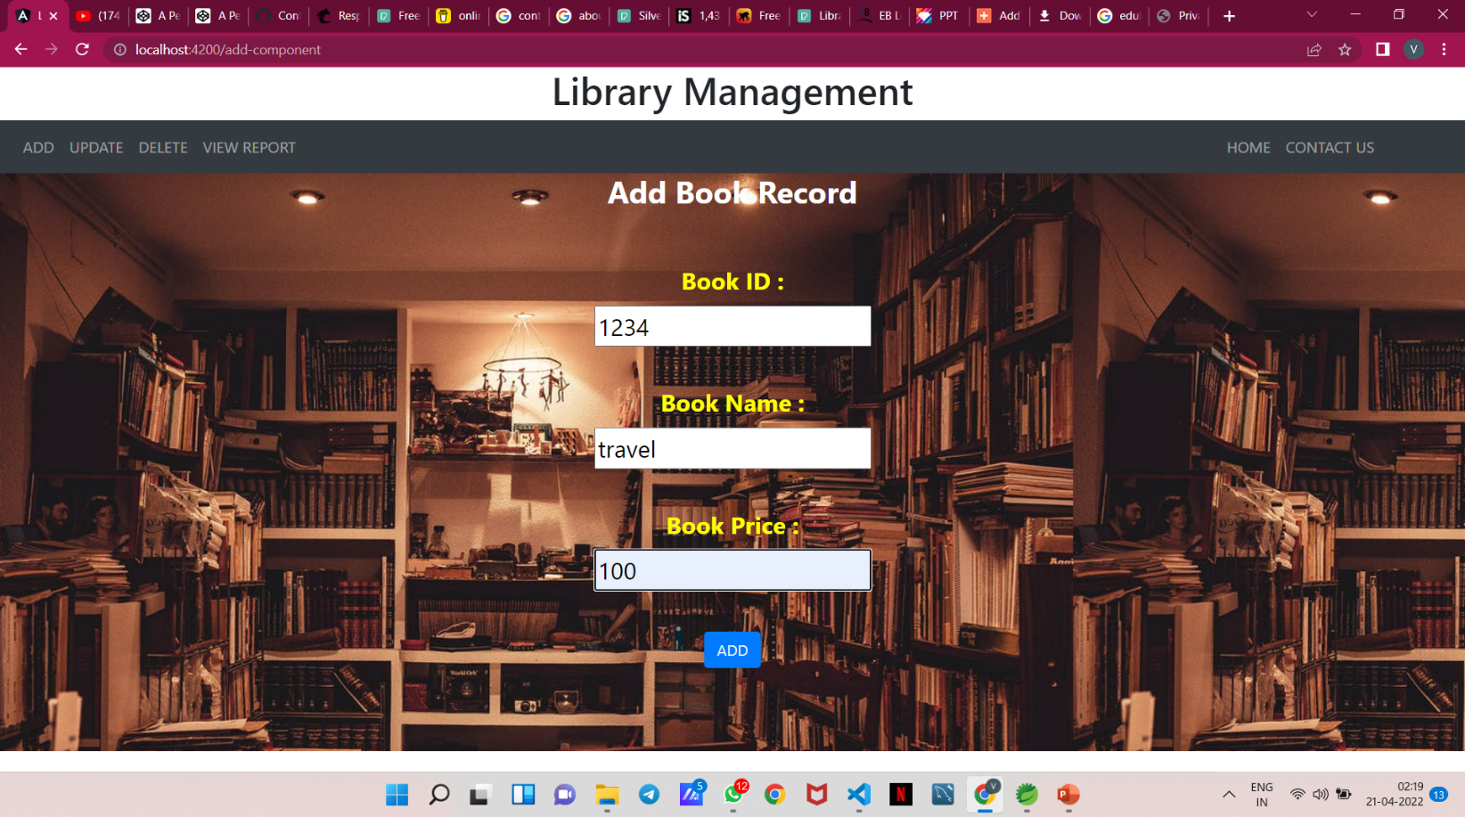
3. ADD BOOK RECORD

Slide 16
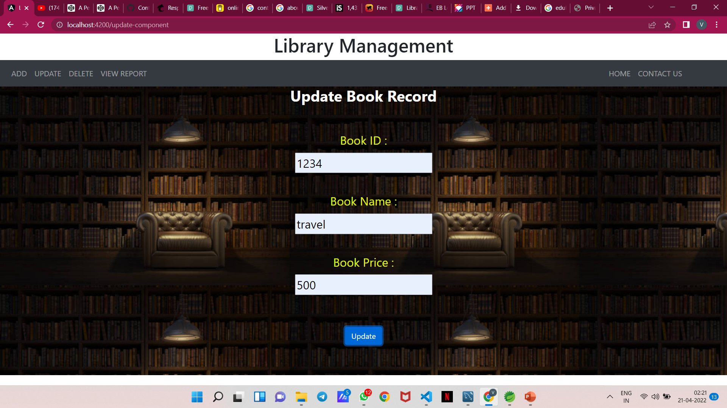
4. UPDATE

Slide 17
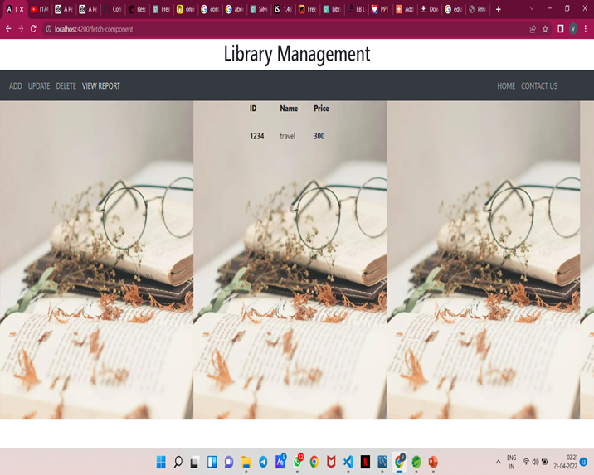
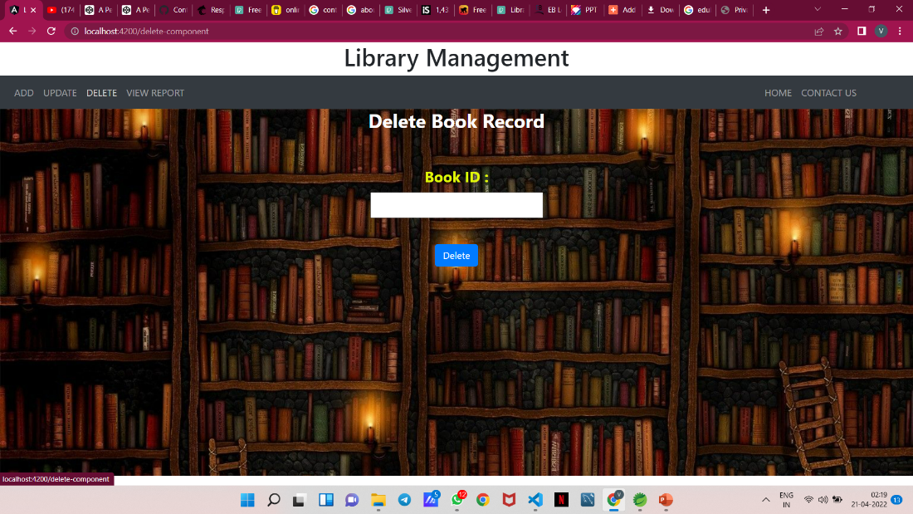
DELETE VIEW
5. DELETE&VIEW

Slide 18
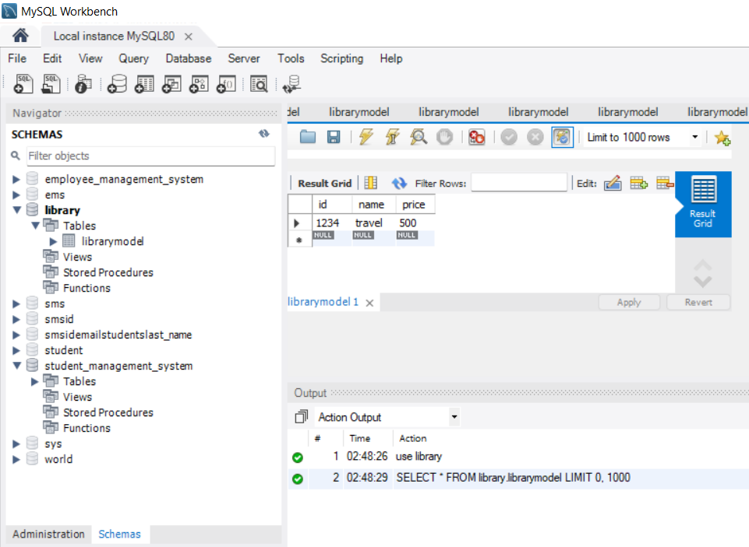
MY SQL SCREENSHOT

Slide 19
https://github.com/VigneshTechnology/finalprojectdemo.git
GITHUB LINK

Slide 20
THANK YOU
“A positive mindset brings positive things.”

